Slide 1
Dependency Inversion Principle
Timothy Klenke

Slide 2
Dependency Inversion Principle
High-level modules should not depend on low-level modules. Both should depend on abstractions
Abstractions should not depend on the details. Details should depend on abstractions.

Slide 3
Goals
All problems in computer science can be solved by another level of indirection, except for the problem of too many layers of indirection. ~ David Wheeler
Good architecture allows you to defer critical decisions. ~ Robert Martin
Single Responsibility, Small, Readable
Composability
Enables unit testability

Slide 4
Dependency Inversion Principle
High-level modules should not depend on low-level modules. Both should depend on abstractions
Abstractions should not depend on the details. Details should depend on abstractions.

Slide 5

Big Ball of Mud

Slide 6

2 Tiered Object Model

Slide 7
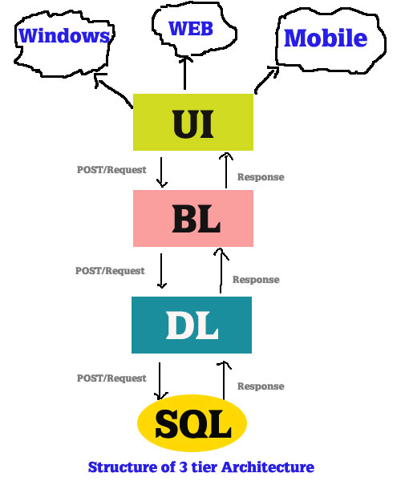
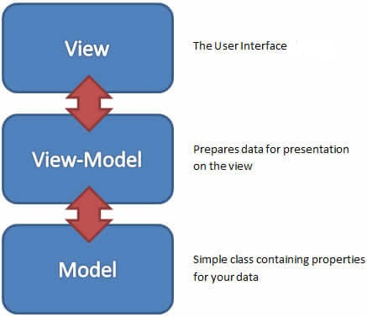
3+ Tiered Object Model

Slide 8
